Slide 1
Strategic Partnerships:
Working with the Career Resource Center
as an Academic Advisor

Slide 2
Who are we?
Allie Ricker
Senior Assistant Director for
Career and Professional Development
Andie Cochran
Assistant Director for
Career and Industry Engagement

Slide 3
Poll Everywhere
Join our discussion throughout the presentation:
Text ALLIERICKER278 to 37607

Slide 4
The CRC’s Organization Structure
Student Focused Team
Employer Focused Team
College Focused Team

Slide 5
Using the CRC Strategically

Slide 6
What are common “career concerns” your students bring into your advising sessions?

Slide 7
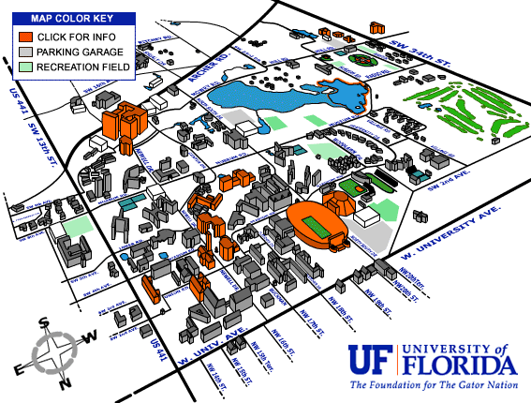
The Exploration Process
1) Student decides they need help
3) Student comes to the CRC for Career Planning
4) Student attends an career event
5) Student talks to faculty member
2) Student goes to see an advisor

Slide 8
Career Planning Appointments
Choosing or Changing Your Major
Exploring Career Opportunities
Resume, Cover Letter, Personal Statement, LinkedIn Critique
Interviewing Strategies
Finding an Internship, Part-time Job, Shadowing, Work Study
Finding a Full-time Job
Graduate School Exploration and Preparation

Slide 9
What happens in a Career Planning Appointment?
Rapport Building
Open-ended questions
Determining Needs
Where have you been already?
Next Steps
What do you still need?
Uncover the story
What questions do you have?
What is your action step?

Slide 10
CHOMP
CHOMP is a very effective first step for exploring students
Referring to each module separately is most effective

Slide 11
Action Steps
Learning outcomes for Career Planning include the student leaving with an “action step”
Additional resource referral
Additional CRC or campus event
Who else needs to be included in the decision-making or career planning process?
Notes:
Bring events handouts

Slide 12
How you can help?
Demystifying what will happen when students come to the CRC
Space to process your decision-making about your major and career
Get connected to additional career information and support
Individualized attention to create your career action plan
Discussing Gator CareerLink as a starting point
The best way for students to get connected is through creating their Gator CareerLink account

Slide 13
Haley the First-Year Student
Haley’s parents tell her she needs to choose her major.
Advisor refers Haley to the CRC for a Career Planning Appointment.
Haley meets with a CRC staff member who inform her that it’s okay that she doesn’t know yet!
Haley visits her academic advisor to determine tracking requirements. She decides Sociology would be a great fit!
Haley discussed which major she should choose with her roommates.
Haley remembers she’s not great a chemistry. She’s not sure what she is interested in.
In their appointment, Haley and the CRC staff member talk about her strengths.
Haley takes time at home to research. Haley decides either Anthropology or Sociology would be great!
Her roommates tell her she should pursue medicine like them.
Academic advisor discusses pre-health requirements and major options.
CRC staff member encourages Haley to take the “Major Exploration” module of CHOMP.
CRC Staff member helps Haley with additional career information regarding the majors.
Haley thinks that sounds like a good idea.
Haley goes to talk to an academic advisor.
Schedules a follow-up appointment for next week to discuss results.
Haley narrows her major choices down to a top 10.

Slide 14
Engaging with Employers

Slide 15
How can you connect with Employers?
Campus Partners Lunches
Meetings
Student Organization Advisor Partnership
Attend Career Events and Career Fairs

Slide 16
Why is it important connect with Employers
Employers want to understand the needs of the students
There are great opportunities you can communicate to students
Understanding what skills employers value can help you help the students
Knowing where the employers recruit (on campus, on Gator CareerLink, their website)

Slide 17
Faculty Module of
Gator CareerLink Demo

Slide 18
Opportunities for Collaborative Programming

Slide 19
How to Collaborate with the CRC
Determine your CRC Contact
Set-up a meeting to discuss ideas and overlap of office goals
Determine your audience and needs

Slide 20
Who is your CRC Liaison?

Slide 21
A Week in the Life of an
Embedded Liaison
Customize programs for Students
Collaborate with Faculty and Staff
Consult with Employers

Slide 22
Exploring Gators Mini-Conference
Collaboration between CLAS Exploratory Team and CRC
Need for a link between major exploration and career exploration
Advertised to students as a “one-stop shop”

Slide 23
Partnership with CLAS-AAC
Referring students during appointments through flyers, introductions, etc.
Assistance to advisors with bringing career information to students
Brought advisor to CRC to share results of exploratory assessment
Collaboration for CLAS Career Day

Slide 24
How can we “work smarter” together?

Slide 25
Questions?
AlexandraR@crc.ufl.edu
AndieC@crc.ufl.edu

