Slide 1
Preeminence in Undergraduate Academic Advising
Jenny Clements and Ty Robare

Slide 2
Background

Slide 3
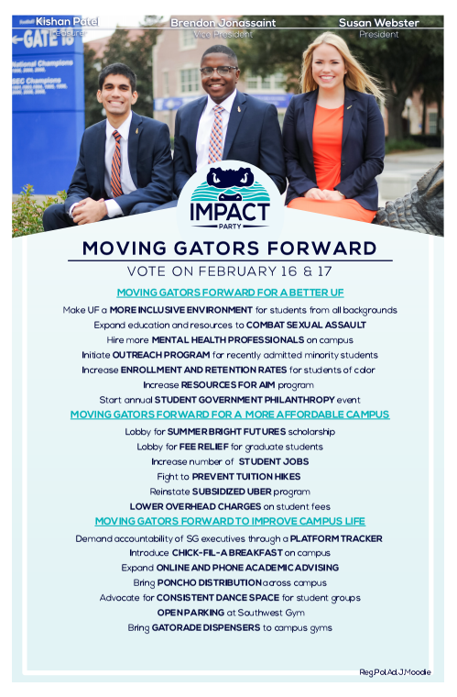
Roots of the Initiative
Student input
Added to the Impact Party platform during the Spring 2016 Student Government elections

Slide 4
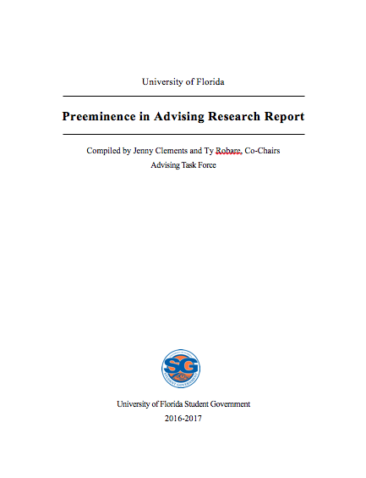
Student Government Advising Task Force
Started May 2016
Focused on internal and external research
UF advising structure by college
Ivy League, Top 10 Public, and Florida Institutions
Completed 32-page research report to present to the Undergraduate Advising Council

Slide 5
Research Report
Internal research looked at structure and asked advisors 4 questions:
1. Does the college offer online or phone advising?
2. How many advisors are on staff?
3. How do you communicate services to students?
4. How does advising factor in to the University’s preeminence plan?

Slide 6
Research Report
External research asked 6 questions:
1. What is the school’s advising model?
2. Is advising centralized in a single department or done independently by college?
3. Who oversees policies for advising at the school?
4. Where does this school most differ from UF’s advising model?
5. What does their advisor to student ratio look like?
6. Is there anything innovative that the school does with advising that stands out?

Slide 7
Research Report
Developed 4 findings
1. Formalize advising structure in each college: defining advisors
2. Improve advisor-to-student ration: NACADA recommended ratio
3. Implement peer advising model for each college: Liberal Arts and Sciences, Engineering, and Arts use peer advisors; many other institutions use university-wide peer advising structure
4. Adopt innovative means of advising: on-call online and phone advising; virtual counseling via Skype; online scheduling

Slide 8
Next Steps
Round out report with the student perspective of UF advising
Developed survey for undergraduate student population
Partnered with the Preeminence in Undergraduate Advising Task Force under the Undergraduate Advising Council
Executed in December 2016

Slide 9
Undergraduate Academic Advising Survey
Question sets:
Demographics: semesters completed, transfer status, college and major
Frequency of advising appointments and seeing the same/different advisor
Use of email, online, and phone advising
Current and ideal means of scheduling appointments or contacting advisor
Wait time length and satisfaction
Overall satisfaction and potential improvements

Slide 10
Survey Results

Slide 11
Results
2,170 responses
Every college had responses

Slide 12
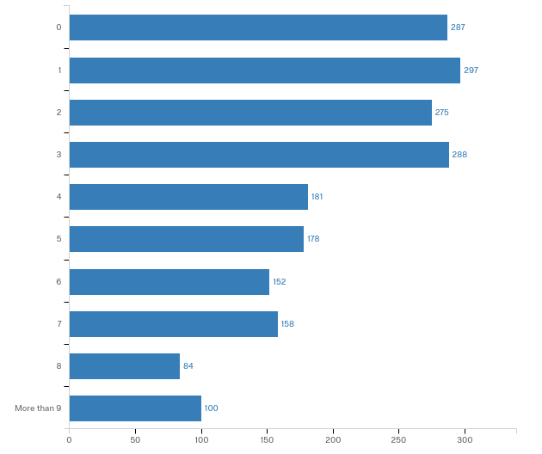
Demographics
Semesters completed

Slide 13
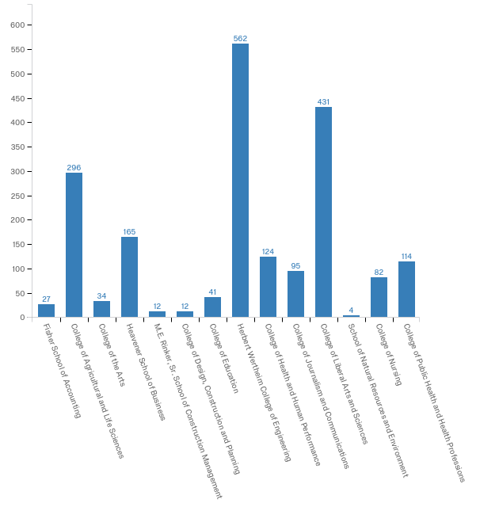
Demographics
College responses

Slide 14
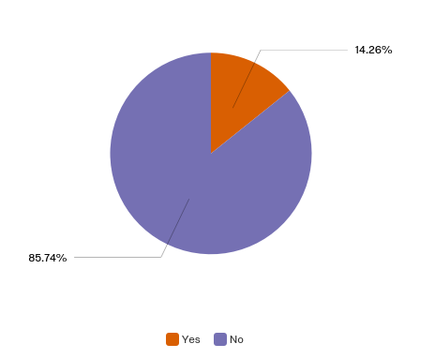
Demographics
Transfer status

Slide 15
Demographics
Program-specific advising

Slide 16
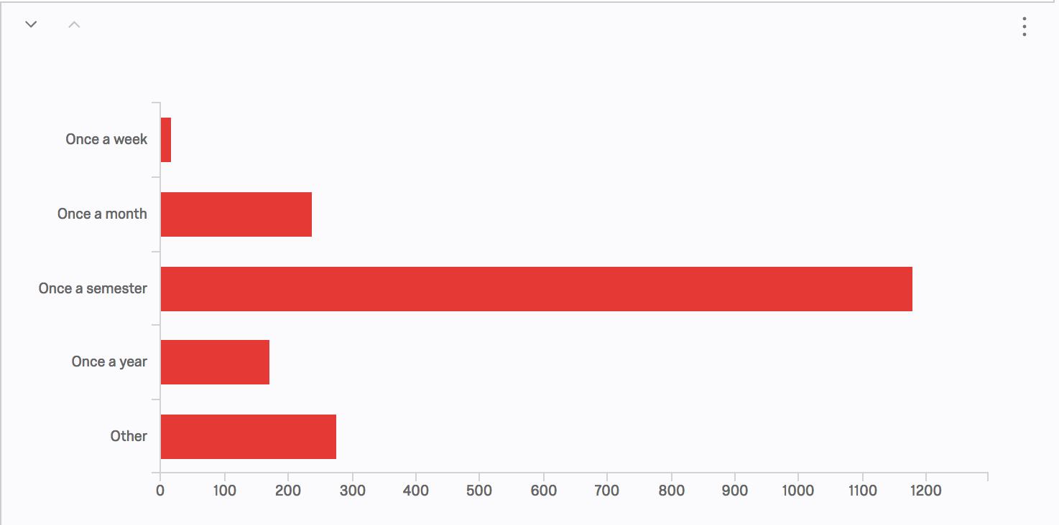
Frequency of Advising Appointments
62.7% visit only once per semester

Slide 17
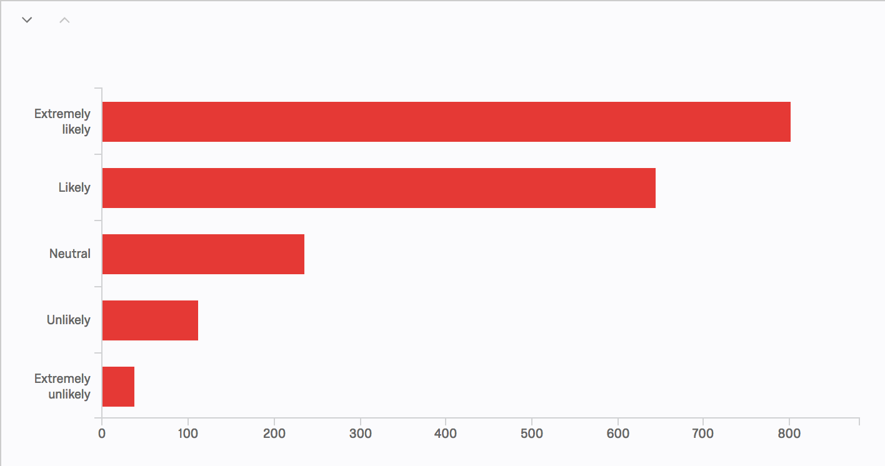
Email Advising
78.94% of respondents answered positively
8.18% of respondents answered negatively

Slide 18
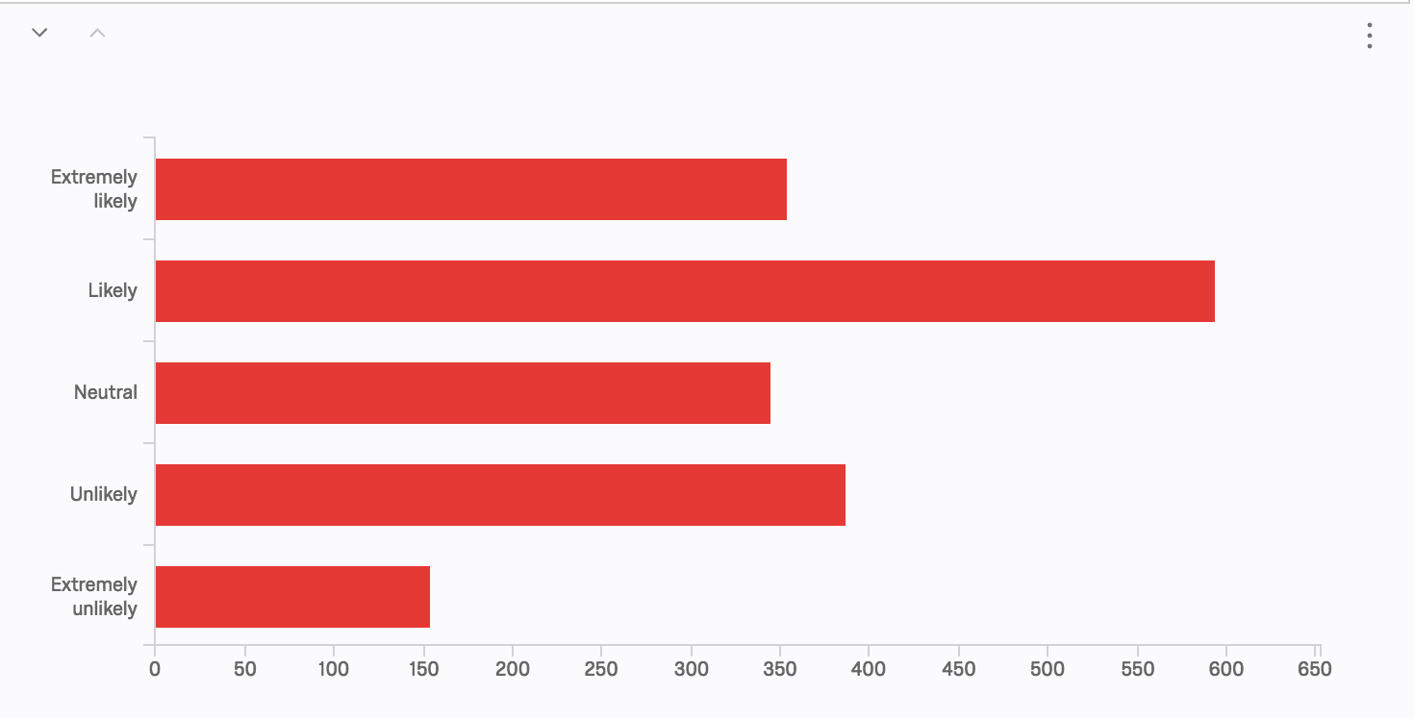
Online Advising (Skype, chat box, etc.)
51.69% of respondents answered positively
29.50% of respondents answered negatively

Slide 19
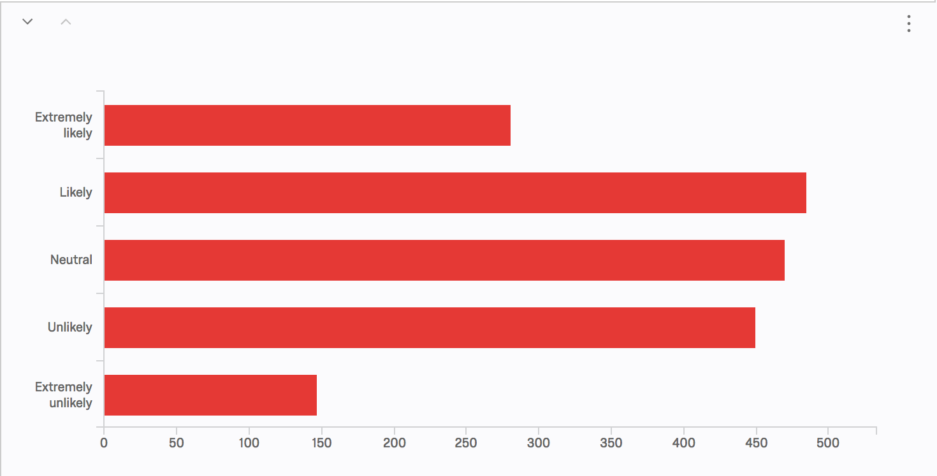
Phone Advising
41.79% of respondents answered positively
32.57% of respondents answered negatively

Slide 20
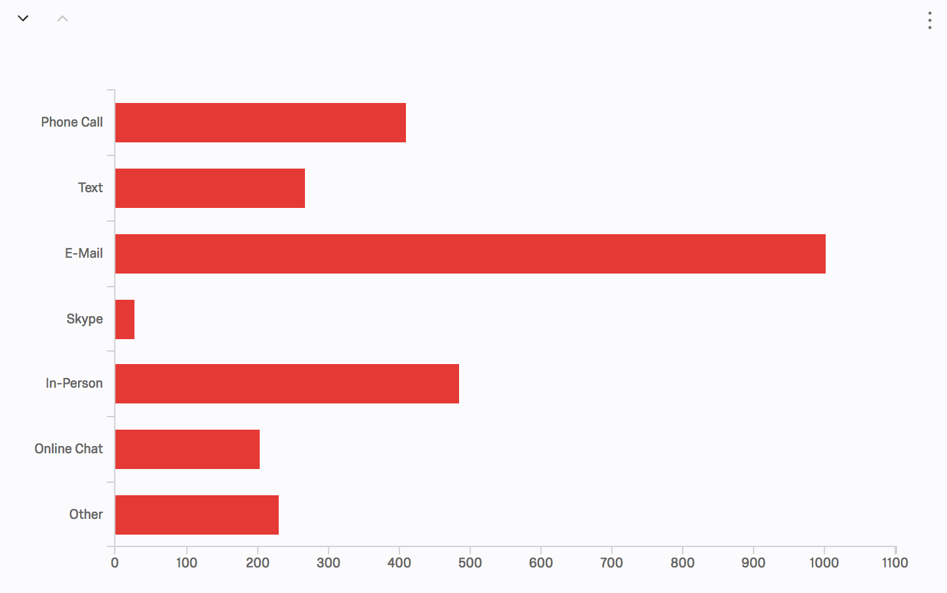
Current and Ideal Means of Scheduling
56.39% of respondents suggested E-Mail
Many “Other” suggestions include online scheduling

Slide 21
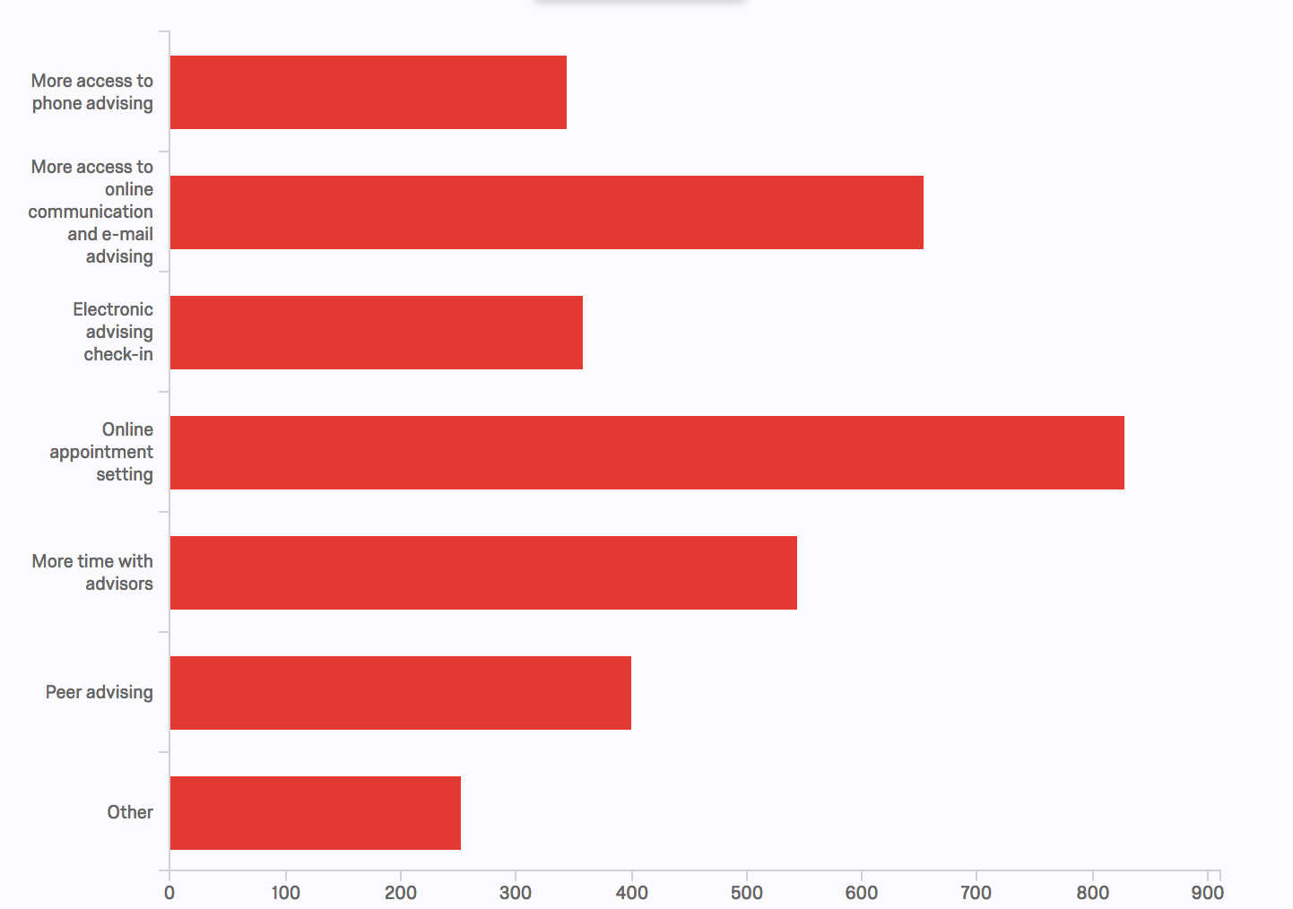
Current and Ideal Means of Contact
76.42% of respondents chose E-Mail
51.83% of respondents chose In-Person

Slide 22
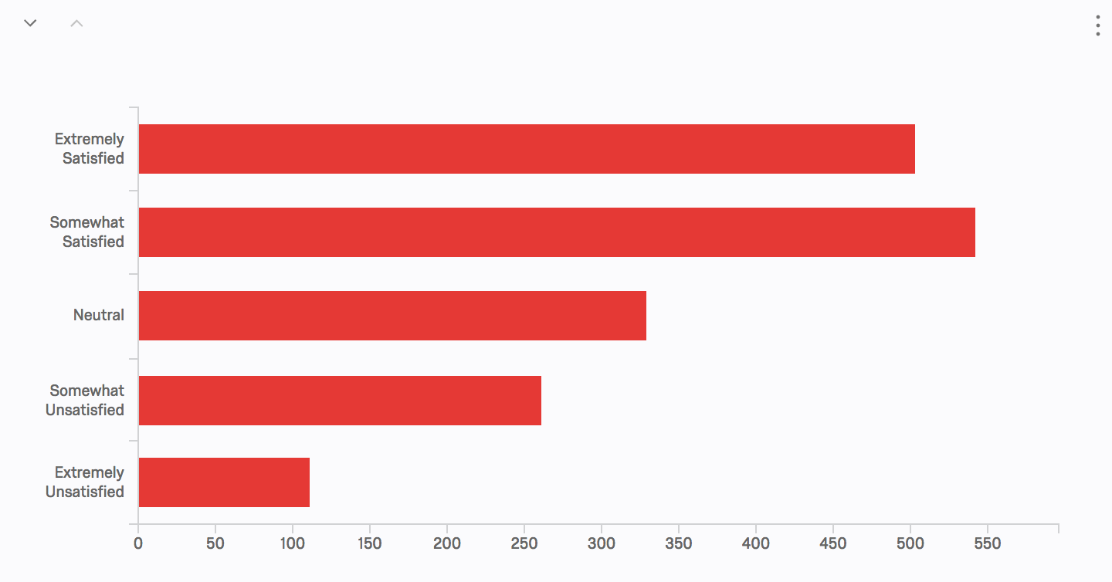
Wait Time Length and Satisfaction
59.85% of respondents answered positively
21.31% of respondents answered negatively (Most from same colleges)

Slide 23
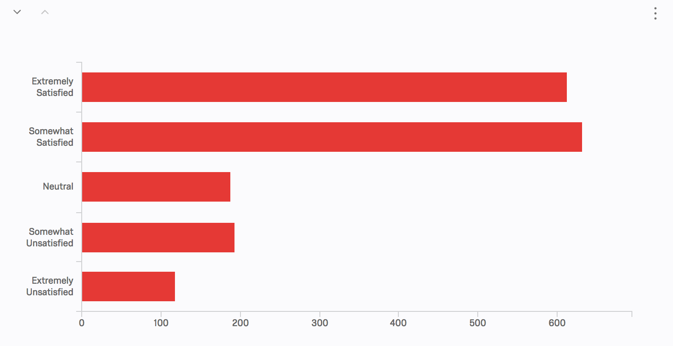
Overall Satisfaction and Improvements
71.39% of respondents answered positively
17.84% of respondents answered negatively
Online appointment setting preferred by majority

Slide 24
Takeaways

Slide 25
Online Scheduling
Based off of “improvements” and “current and ideal means of scheduling” responses
A few colleges and departments currently practice online scheduling: Engineering, Agriculture and Life Sciences

Slide 26
More Email and Online Communication
Based on “current and ideal means of scheduling and contacting” and “improvements” responses

Slide 27
Conclusions
Overall goal: defining and reaching preeminence in undergraduate academic advising
Next steps: Advisor survey

