Slide 1
Post-Graduate Transitions Embedding UF Student Outcome Data into Strategic Advising Conversations
Sam Kennedy
Assistant Director for Assessment & Planning
UF Career Resource Center

Slide 2
Overview
Introduction
Student outcome resources
Approaches to student outcomes conversations
Discussion/Questions

Slide 3
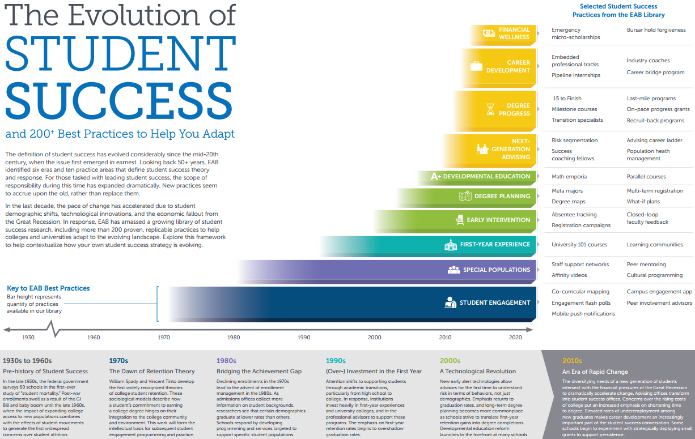
Student Outcome Trends in Higher Ed
Source: EAB Student Success Collaborative (10/24/2016)

Slide 4
UF Student Outcomes: UF Graduation Survey
Who: 95% of all UF graduates (Undergraduate, Master’s, Doctoral, Professional)
Hold placed on release of transcripts until UF Graduation Survey completed or survey window closes
When: 2 weeks prior to Commencement through 7 weeks after graduation
Occurs each 3 times per year (Summer + Fall + Spring = Academic Year)
Majority complete it within 2 weeks prior to graduation, therefore showing a snapshot of where UF graduates are in their transitions to post-graduate destinations at the time of graduation
How: ONE.UF student portal
Coordinated by - Office of Institutional Research & Planning, Office of the University Registrar, Career Resource Center, and Campus Labs (Baseline survey tool)
UF Graduation Survey data steward = UF Office of Institutional Research & Planning
Why: Snapshot of ROI for UF stakeholders (chief among them = students)
Trends in student employment and advanced degree, impact factors (e.g. internships, research, job search resources)

Slide 5
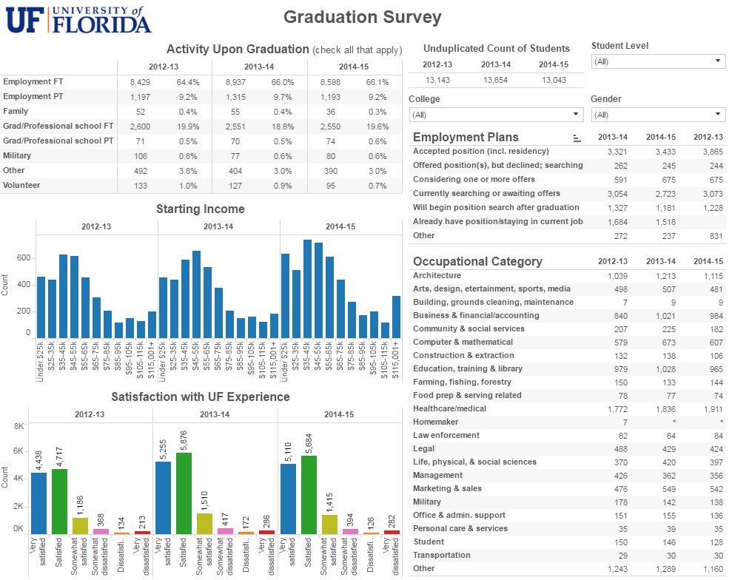
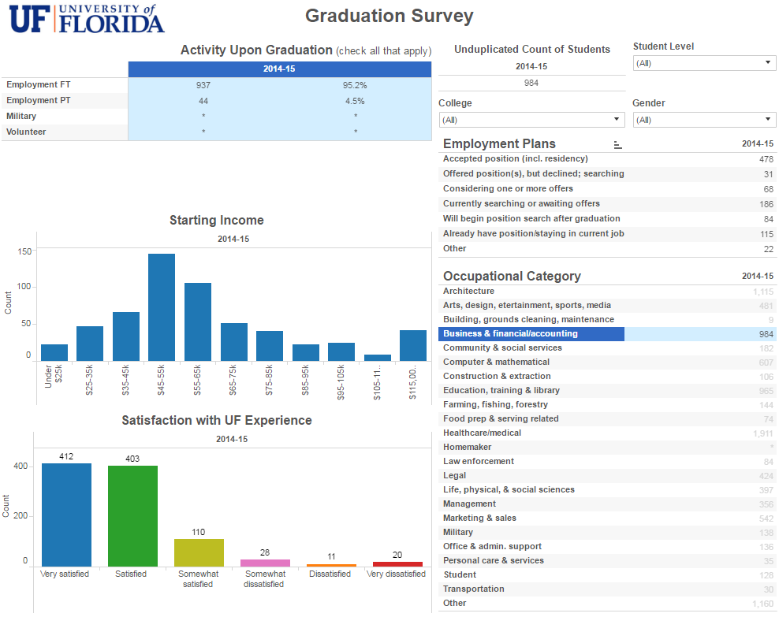
Job Search Resources: UF OIPR
Source: http://ir.aa.ufl.edu/ug-and-grad-survey

Slide 6
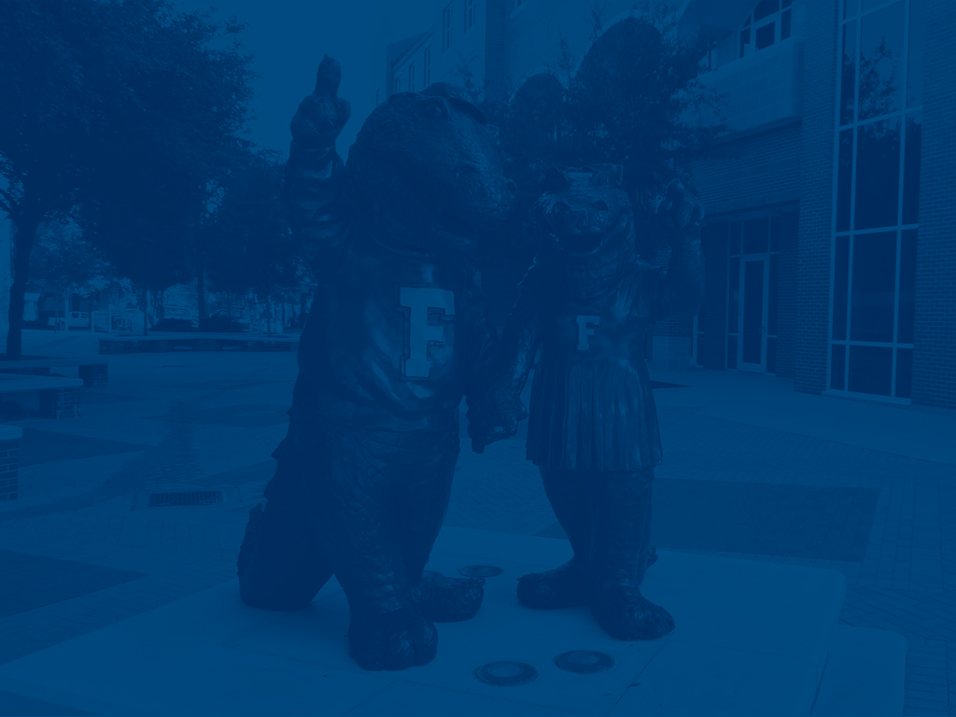
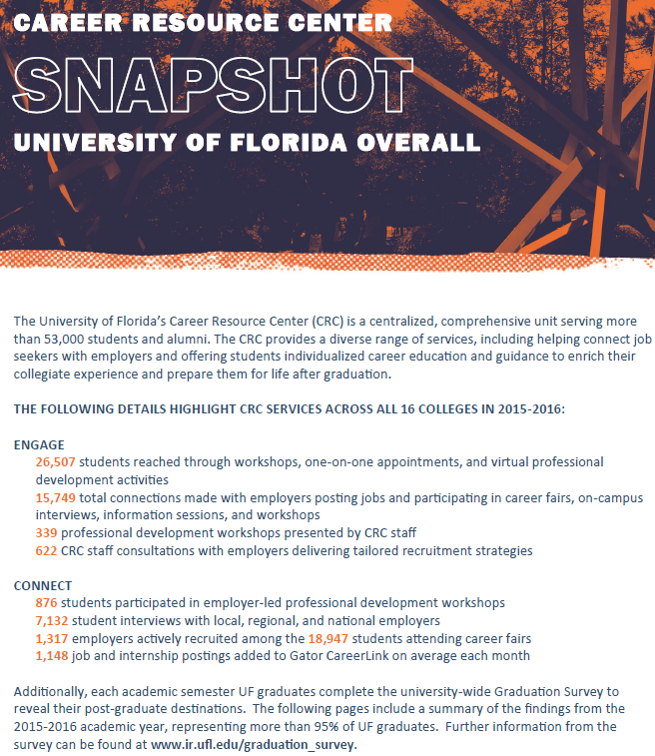
UF CRC College Snapshot Report
Notes:
Here are some examples of experiential education

Slide 7
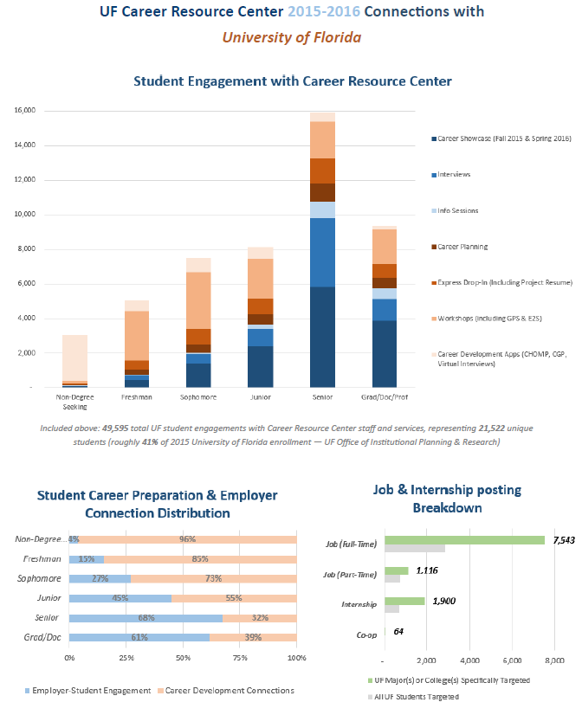
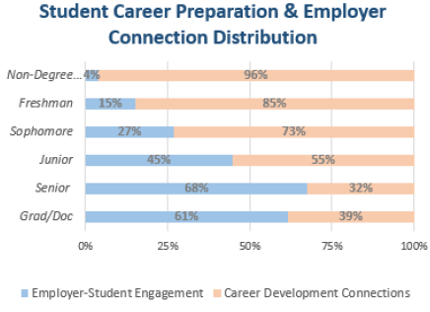
UF CRC College Snapshot Report
Included: 49,595 total UF student engagements with Career Resource Center Staff and services, representing 21,522 unique students (roughly 41% of 2015 University of Florida enrollment – UF Office of Institutional Planning & Research)

Slide 8
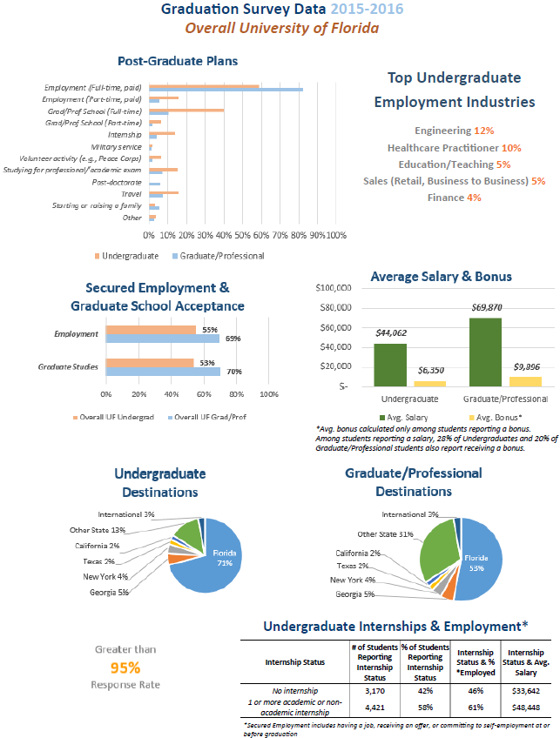
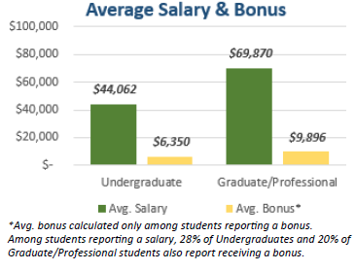
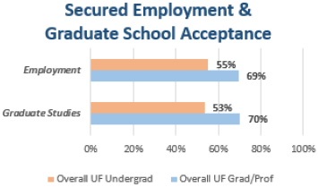
UF CRC College Snapshot Report:
Student Outcomes

Slide 9
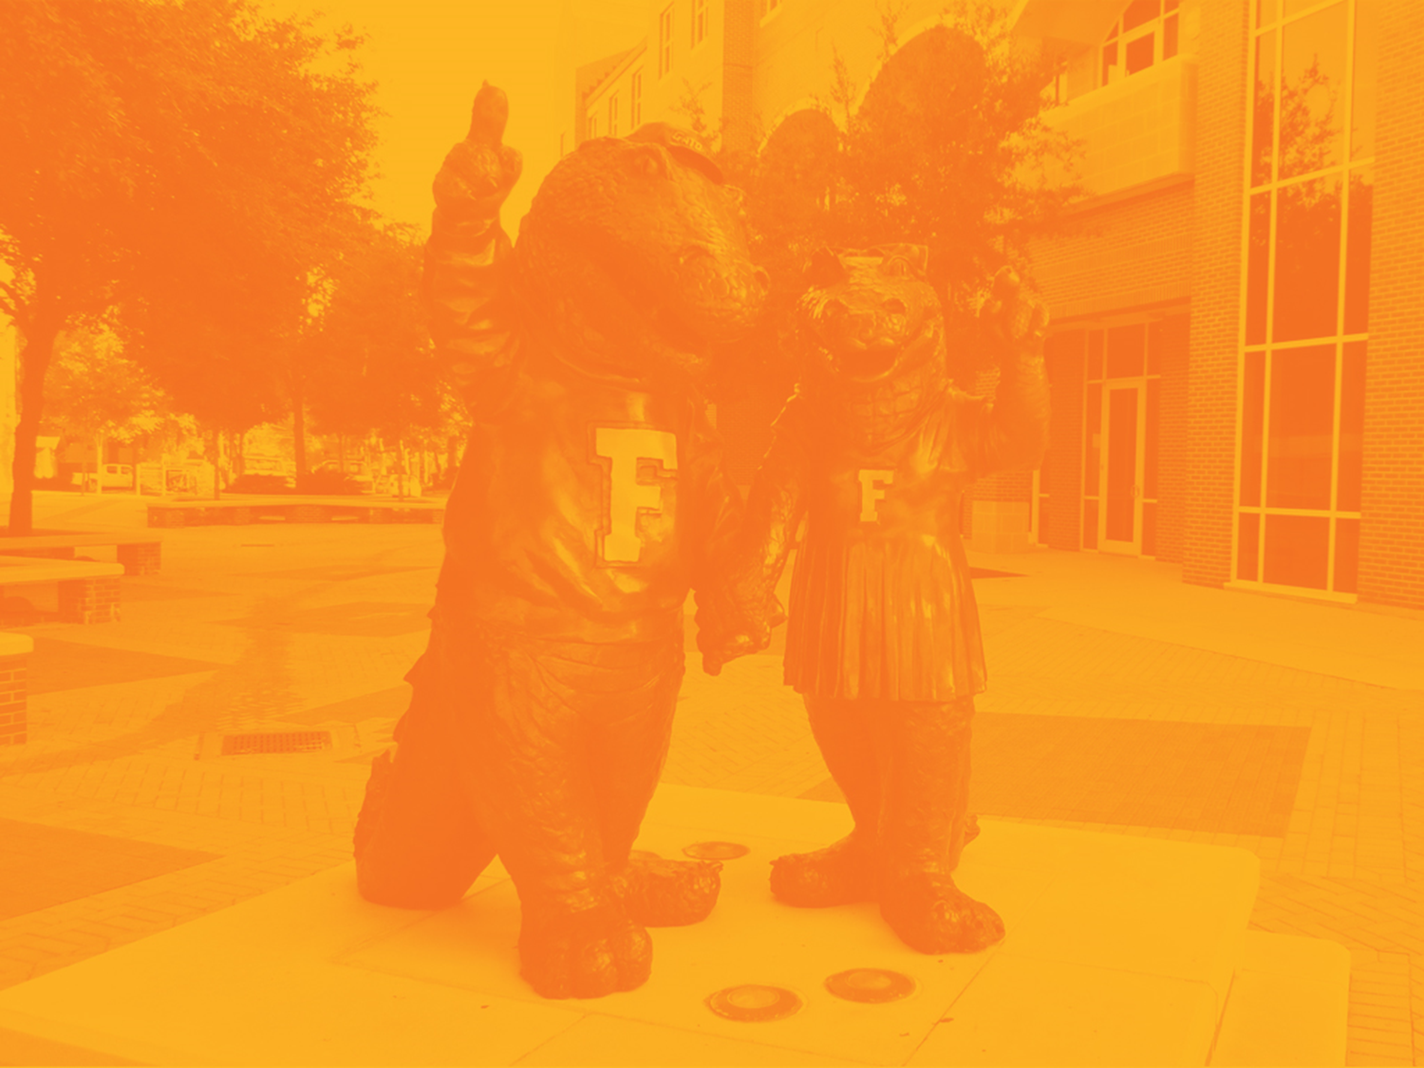
Student Outcome Resources: O*NET
Notes:
Read the slides above..
Give an example of some organizations/clubs or jobs or volunteer work at UF

Slide 10
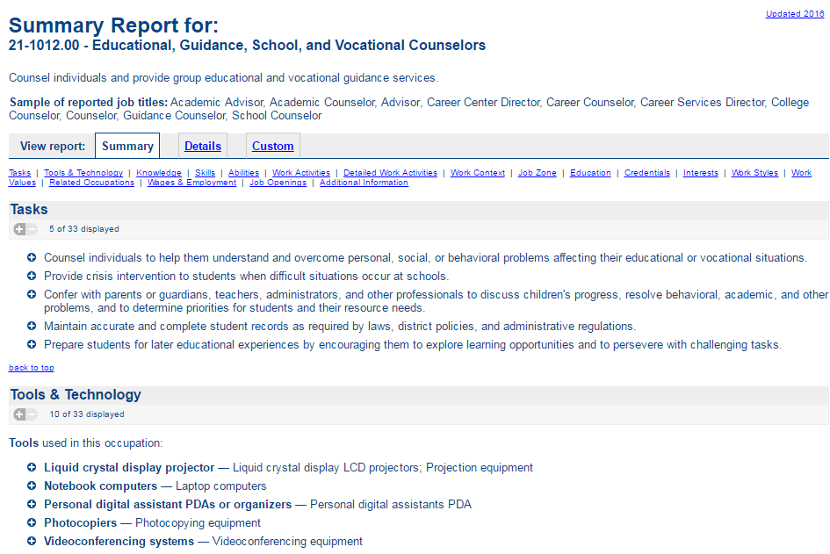
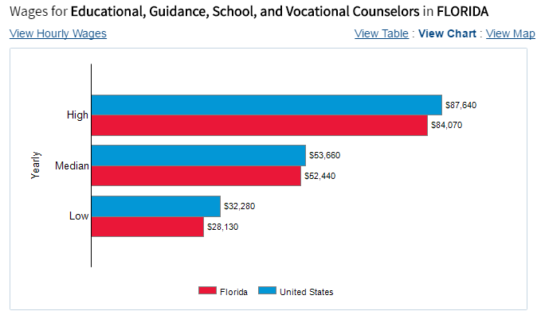
Student Outcome Resources:
O*NET

Slide 11
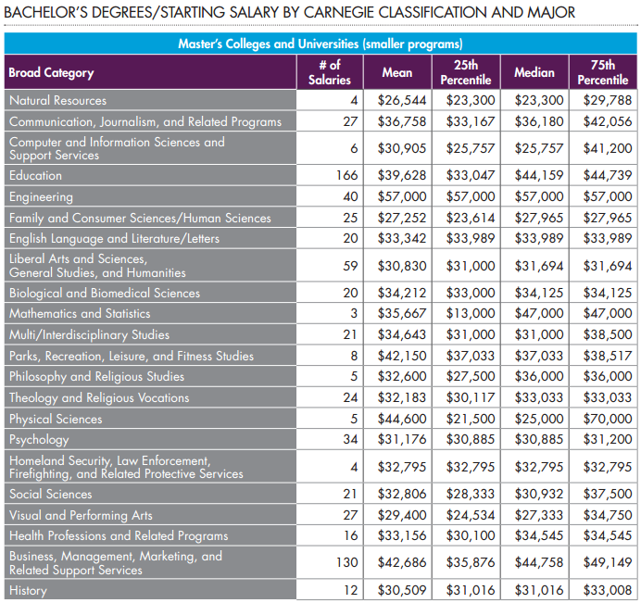
Student Outcome Resources:
NACE

Slide 12
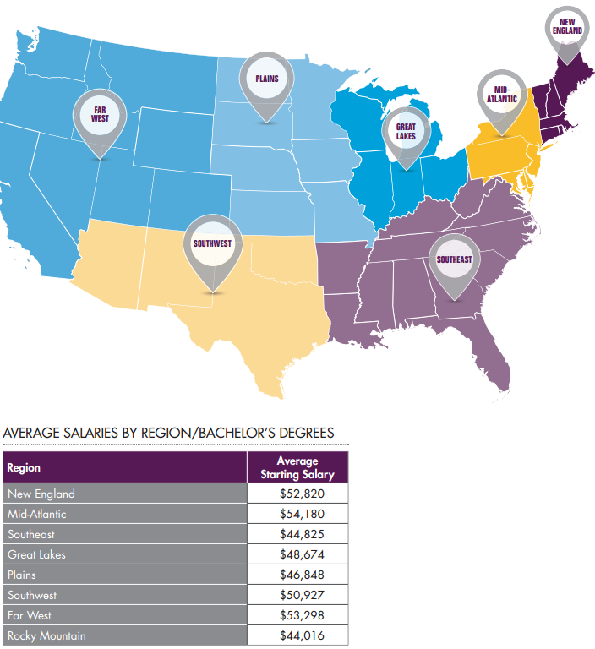
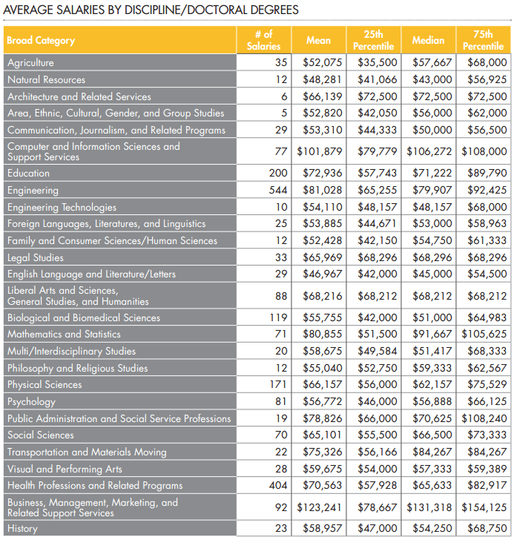
Student Outcome Resources:
NACE

Slide 13
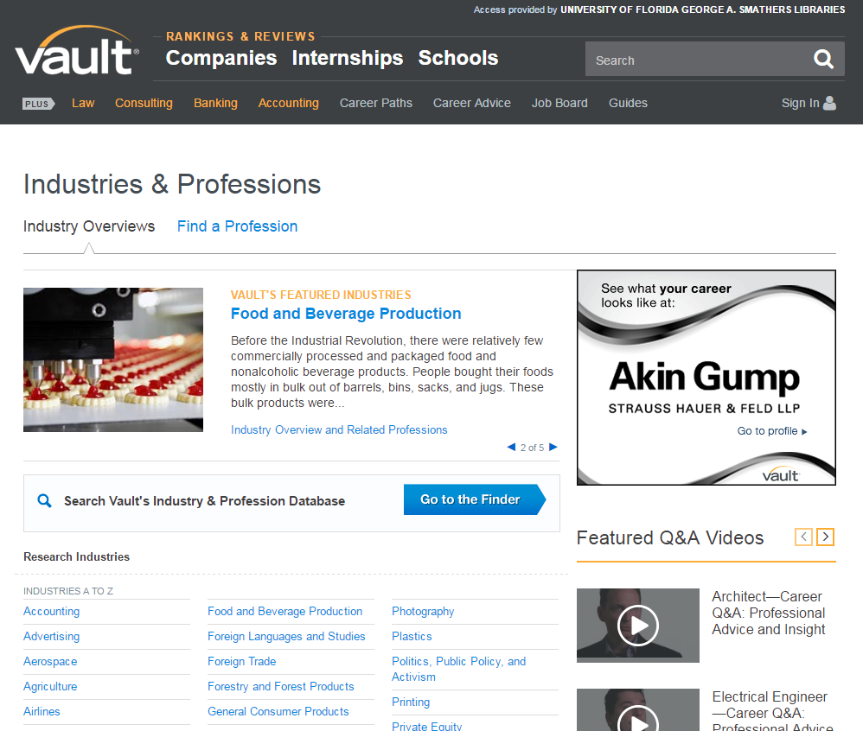
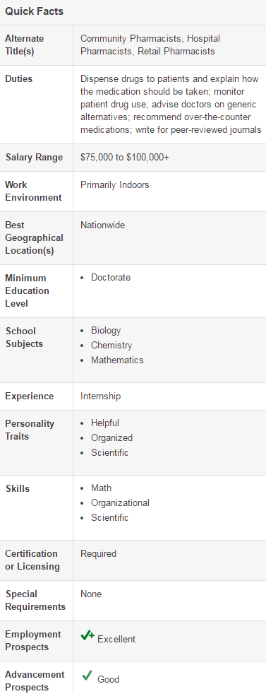
Career Exploration Resources:
Vault.com

Slide 14
Student Outcome Conversations
Gauge comfort level - be self-aware of your comfort level with student regarding conversation topic and relevant student outcome information/resources
Identify approach that best fits conversation:
High-level Discussion: general probing questions and identification (e.g. have you thought about…?, what do you expect to be doing in the weeks and months following graduation?)
Specific/Targeted Discussion: connecting specific goals with action-oriented probing questions (e.g. next steps, support mechanisms, timeline)
Resource Referral: faculty contacts, professional contacts, web resources, and…
UF CAREER RESOURCE CENTER (workshops, one-on-one career planning, express resume reviews, specific presentation requests for clubs/departments, career fairs, networking events, CHOMP major and career exploration tool)
3) Confirm next action step(s)
Notes:
Here are some examples of experiential education

Slide 15
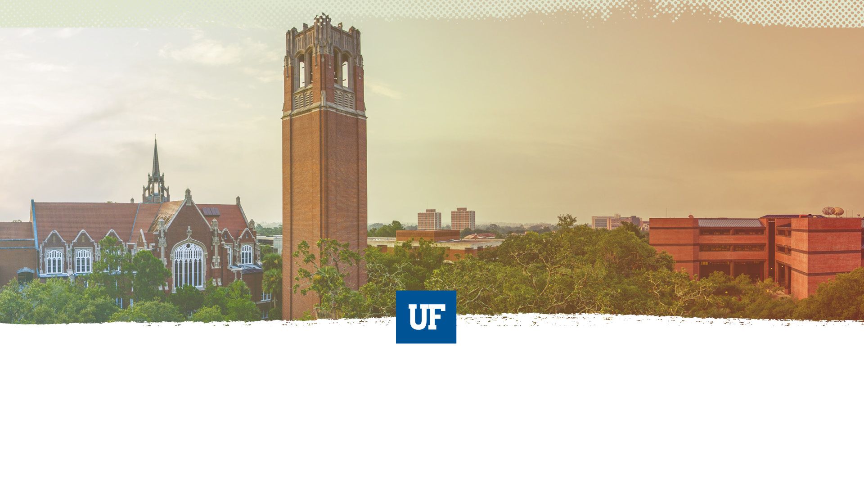
Questions &
Discussion

