Slide 1
Lessons from Students with Learning Disabilities at the University of Florida.
Consuelo Kreider, PhD, OTR/L, ckreider@ufl.edu
Beth Roland, M.A. C.A.G.S., bethr@dso.ufl.edu
Ashley Jacobs, M.Ed., Ed.S., ajacobs@advising.ufl.edu
Mei-Fang Lan, PhD
Claudia Luna
Angela Sexton
Mackenzi Slamka
Rachelle Newland
January 30, 2017
Emerson Alumni Hall
University of Florida
UAC's 11th Annual Advising Conference

Slide 2
Learning Disabilities & Attention Disorder
Most prevalent disorder on college campuses
  ~60 % of students reporting a disability¹
Life long disorder; Invisible disability
  A neurological disorder that affects the brain's ability to receive, process, store, and respond to information²
Learning Disabilities = “umbrella” term
  Specific LD diagnosis can vary from person to person
~ 31-45% of individuals with LD or AD have both³
U.S. Department of Education, National Center for Education Statistics. (2015). Digest of Education Statistics, 2013 (2015-011), Chapter 3.
Cortiella, Candace and Horowitz, Sheldon H. The State of Learning Disabilities: Facts, Trends and Emerging Issues. New York: National Center for Learning Disabilities, 2014.
DuPaul, et al., 2013. DOI: 10.1177/0022219412464351
Notes:
https://nces.ed.gov/fastfacts/display.asp?id=60
Students with learning disabilities (LD) comprise approximately 60% of students reporting a disability in postsecondary education ^{[1]}
Academics and social encounters can be negatively impacted for students with LD
Students with LD need more than classroom accommodations to succeed, yet relatively few empirical studies inform as to needs beyond the classroom
http://ldaamerica.org/symptoms-of-learning-disabilities/ retrieved 2015-10-20;
“Some of these symptoms can be found in all children at some time during their development. However, a person with learning disabilities has a cluster of these symptoms which do not disappear as s/he grows older.”
Most frequently displayed symptoms:
short attention span,
poor memory,
difficulty following directions,
inability to discriminate between/among letters, numerals, or sounds,
poor reading and/or writing ability,
eye-hand coordination problems; poorly coordinated,
difficulties with sequencing, and/or
disorganization and other sensory difficulties.
Other characteristics that may be present:
performs differently from day to day,
says one thing, means another → responds inappropriately in many instances,
distractible, restless, impulsive,
doesn’t adjust well to change,
difficulty listening and remembering,
difficulty telling time and knowing right from left,
difficulty sounding out words,
reverses letters,
places letters in incorrect sequence,
difficulty understanding words or concepts, and/or
delayed speech development; immature speech.
From: http://ldx.sagepub.com/content/46/1/43.long (DuPaul, et al., 2013. DOI: 10.1177/0022219412464351)
“The prevalence of ADHD among students with LD in these samples is roughly 7 times higher than the prevalence of ADHD in the general population, which is approximately 5% (Polanczyk, Silva de Lima, Lessa Horta,
Biederman, & Rohde, 2007)”
“One promising hypothesis is that ADHD and reading disabilities share a common, biological etiology that is based in
a genetic predisposition to both disorders (Willcutt et al.,2005). Recent studies have identified specific alleles that
may be associated with increased risk for both ADHD and reading disability (RD; Willcutt et al., 2002), and a genetic
link between symptoms of ADHD and academic achievement has also been supported by twin studies (Saudino &
Plomin, 2007). Based on this hypothesis, individuals with ADHD only, RD only, and ADHD plus RD would share
some neuropsychological functioning deficits, a hypothesis supported by the results of Willcutt and colleagues (2005). It is possible that deficits may be related to working memory and processing speed, as such difficulties are shared across ADHD and LD (DuPaul & Volpe, 2009).”

Slide 3
Learning Disabilities at UF
Average of 1,325 students with disabilities registered with the DRC during 5-year period of 2009-2014 ( 2.6% of total UF student population)
DRC Student Population July 2016
  26% Attention Disorders
  19% Learning Disorders
Students with LD
    ½ rate (21%) attendance at 4 year college versus general population (40%); 2x rate attendance at 2-year college²
    College completion rates: 41% (LD) versus 52% in general population¹
    11% of Students with LD report disability to college/university²
Cortiella, Candace and Horowitz, Sheldon H. The State of Learning Disabilities: Facts, Trends and Emerging Issues. New York: National Center for Learning Disabilities, 2014.
NLTS-2, 2011 : http://www.nlts2.org/data_tables/tables/14/np5S5i_K8g_YNfrm.html retrieved August 11, 2016
Notes:
Average of 1,325 students with disabilities registered with the DRC during 5-year period of 2009-2014
- equates to 2.6% of total UF student population
~ 52,000 UF students → 10% = 5200
2015: 52500 students at UF; 2016 DRC students
Percentage by student classification:
80% Undergraduate
14% Graduate
6% Graduate Professional

Slide 4
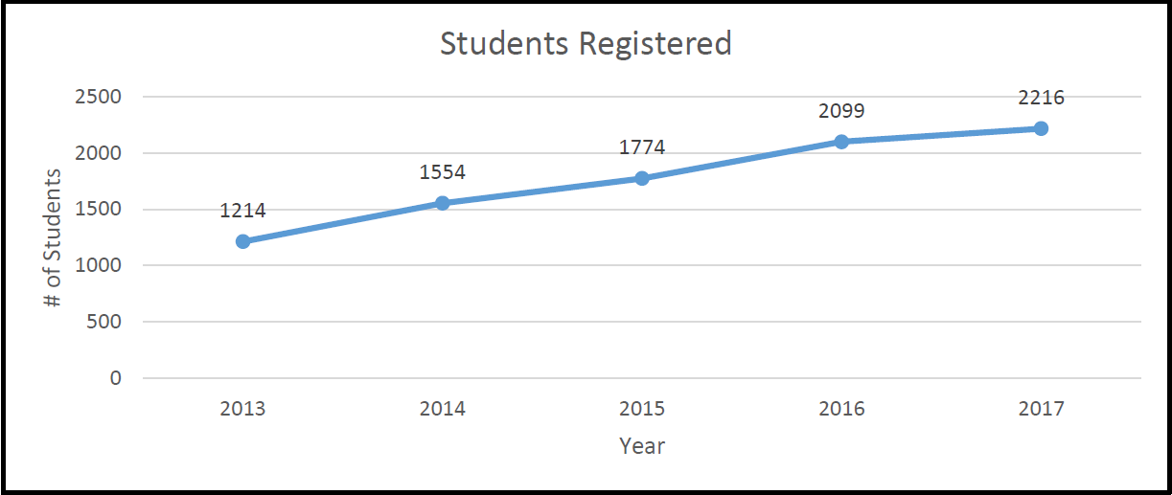
UF DRC Student Population
Notes:
Infographic from Beth:
DRC enrollment has been greatly increasing during the past 5 years
Reasons including more students entering college with disabilities, better marketing of our office, more outreach events, awareness being raised through CS3LD research, decreasing stigma of disability

Slide 5
Challenges for Students with LD/AD
Often unaware of how their LD symptoms impact their academic and essential life skills¹ – more difficulty with:
  Time management; maintaining effective daily routines
  Coping with stress; communicating needs
  Organizational skills
  Problem solving skills
Need strong supports; lower self-esteem¹
  Often unaware of / under-utilize resources and support services
  ↑ Self-efficacy, ↑ academic persistence, ↑ effectiveness of strategy use²
Reiff, H., Hatzes, N., Bramel, M., & Gibbon, T. (2001). The Relation of LD and Gender with Emotional Intelligence in College Students. Journal of Learning Disabilities, 34(1), 66-78.
Pajares, F. (1996). Self-efficacy beliefs in academic settings. Review of educational research, 66(4), 543-578.
Notes:
“Perceived Self-efficacy. Self-efficacy also has emerged as a prominent and influential concept within SCT. Self-efficacy reflects individuals' beliefs about whether they can achieve a given level of successful at a particular task (Bandura, 1997). Students with greater self-efficacy are more confident in their abilities to be successful when compared to their peers with lower self-efficacy. Self-efficacy has proven useful for understanding students' motivation and achievement in academic contexts. Higher levels of perceived self-efficacy have been associated with greater choice, persistence, and with more effective strategy use (Pajares, 1996).”
Higher levels of perceived self-efficacy have been associated with greater choice, persistence, and with more effective strategy use - Pajares, F. (1996). Self-efficacy beliefs in academic settings. Review of educational research, 66(4), 543-578.
College students with LD have more difficulty with essential life skills, such as time management, coping with stress, problem solving, and communicating their academic and personal needs to others (Reiff, Hatzes, Bramel & Gibbon, 2001). The emotional well-being of students with LD has been observed to be lower than that of their non-disabled peers (Davis, Nida, Zlomke, & Nebel-Schwalm, 2009). Thus, it is essential to improve the academic success of students with LD by providing them with supports to promote health and healthy life skills (Needham, Crosnoe, & Muller, 2004). Unfortunately, universities rarely provide services tailored to the unique life skills and health needs of students with LD (Reed, Lund-Lucas, & O’Rourke, 2003).
Reiff, H., Hatzes, N., Bramel, M., & Gibbon, T. (2001). The Relation of LD and
Gender with Emotional Intelligence in College Students. Journal of Learning
Disabilities, 34(1), 66-78.
Needham, B., Crosnoe, R., & Muller, C. (2004). Academic Failure in Secondary School: The Inter-Related Role of Health Problems and Educational Context. Social Problems, 51(4), 569-586.
Reed, M. J., Lund-Lucas, E., & O’Rourke, K. (2003). Standards of Practice in Postsecondary Special Needs Programming: Student and Administrator
Opinion. Canadian Journal of Higher Education, 33(2), 27-56.

Slide 6

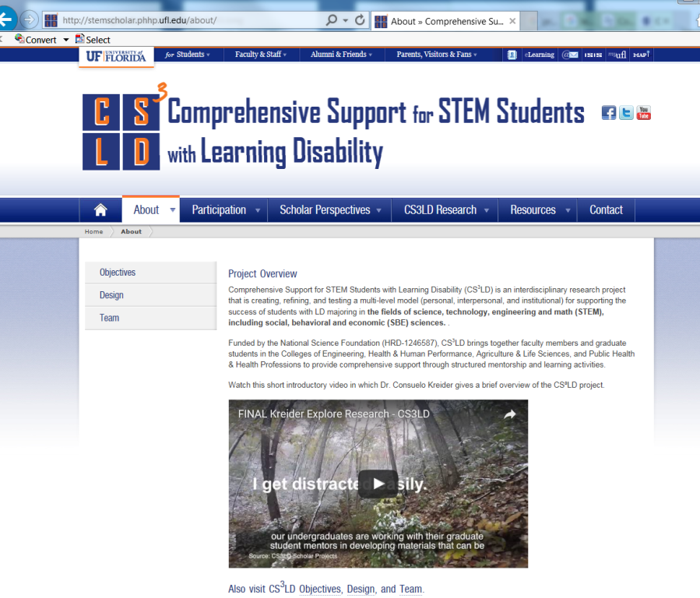
Comprehensive Support for STEM Students with Learning Disabilities (CS³LD)
http://stemscholar.phhp.ufl.edu/

Slide 7
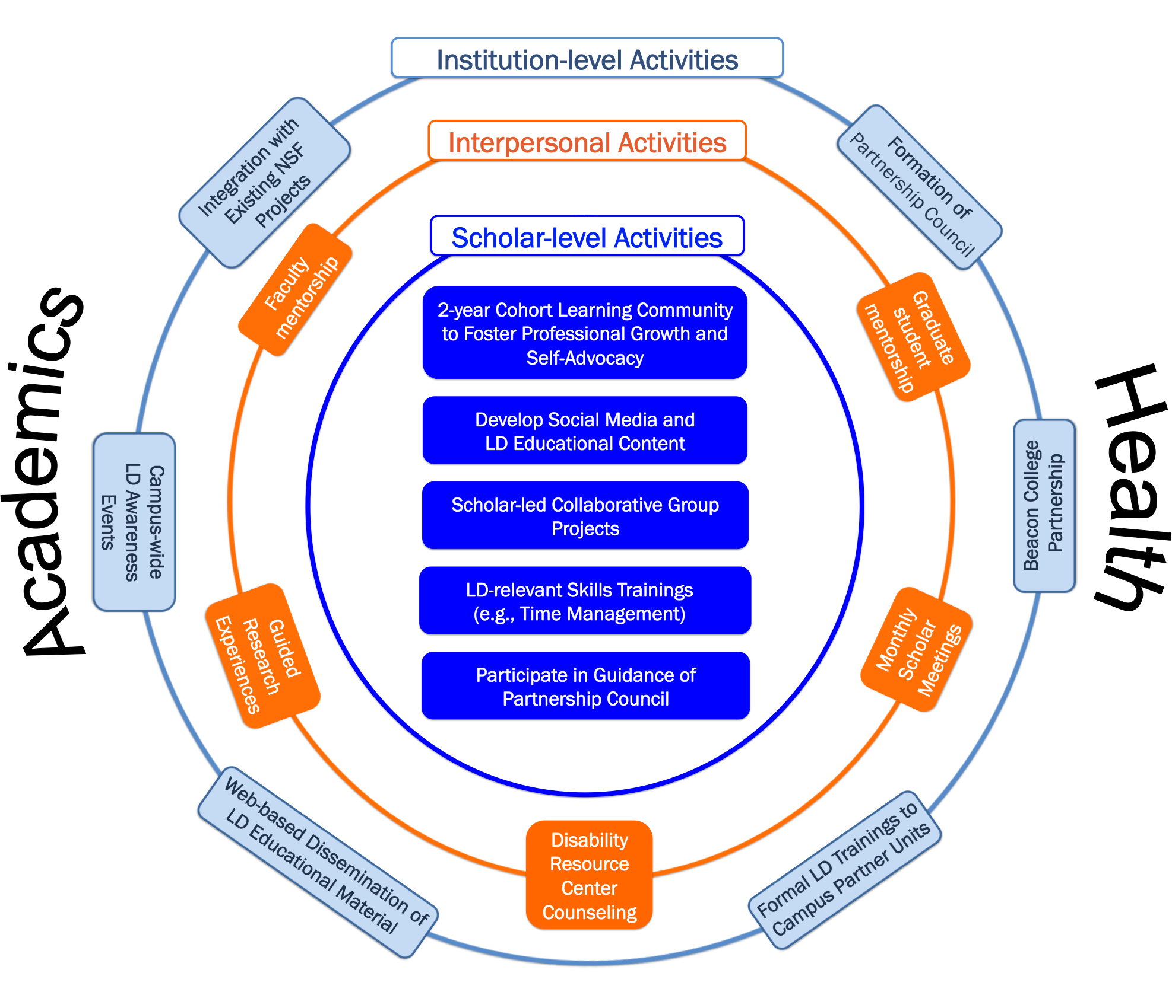
Notes:
For most students being a college student coincides with expectations for greater self-directed performance (i.e., self-regulation) both within the classroom and in areas beyond - have expectations for greater self-regulation of their own daily living routines, health and wellness, and social interactions.
C-SWD must not only master self-regulation of actions within the classroom and beyond, they must also master tasks specific to managing their disability and garnering supports for their disability-related needs within each of these areas.
Based on this understanding, we developed and are refining
The CS3LD model is grounded in Social Cognitive Theory (SCT), which posits that a student’s knowledge and beliefs, together with the university environment, influence necessary behaviors for academic success and overall health/well-being.
Model underpinnings → that personal, interpersonal, and institutional level factors interact continuously to affect academic and individual outcomes of undergraduate students with L/AD.
Objective: Implement, refine and test a multi-disciplinary, multi-modal, multi-level model of support for undergraduates with LD – holistic → academics/professional development + health & wellness
The CS3LD model reflects a systems approach whereby we posit that institutional, interpersonal, and personal factors interact to affect the academics and health and wellness of students with L/AD
The CS3LD model is grounded in Social Cognitive Theory, which posits that a student’s knowledge and beliefs, together with the university environment, influence necessary behaviors for academic success and overall health/well-being. CS3LD is a socio-ecological model designed to simultaneously address these multiple level factors.
Supporting academics, while addressing health and disability issues by building academic and health self-advocacy.
Supports provided at the individual, interpersonal, and institutional levels.

Slide 8
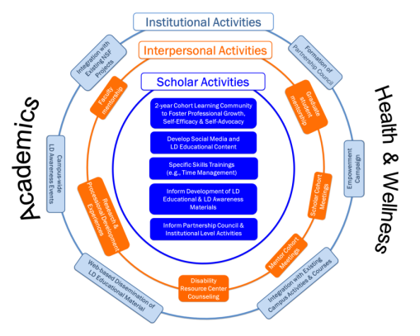
CS³LD Activities
Personal: Undergraduate Group Trainings: self-advocacy; understanding symptoms & capacities; time & stress management
Interpersonal: Mentors →
  professional enculturation: helping understand the reality of their field – guided discovery
  social support: acknowledging their hard work
  empowerment mentor: instilling confidence to make decisions
Institutional: Faculty & Administrators → Institutionalization of awareness & UDL training
Notes:
At the individual level we provide a cohort of undergraduates with LD with training on topics such as stress and time management, and understanding and communicating about their LD.
At the interpersonal level: We match the undergrads with a graduate student mentor in their field of study and we provide the mentors ongoing training regarding LD.
At the institutional level: We’ve formed a University Level Partnership Council made up of representatives from the Provosts offices, Dean’s offices, and Student Services Directors. As a group, the council is looking for ways to institutionalize activities that promote awareness of disability and universal design for learning. We intend to impact the culture of how LD is supported on campus.

Slide 9
Meaningful Discussion Topics to our Scholars
Neurology of LD/AD
Cognitive Styles Common To LD/AD^{1,2}
Big Picture Thinking (Interconnected Reasoning)
Dynamic Reasoning
Narrative Reasoning
3-Dimentional Spatial Reasoning
Eide, B. L., Eide, F. F. (2011) The Dyslexic Advantate Unlocking the Hidden Potential of the Dyslexic Brain. Plume: New York.
http://www.dyslexicadvantage.org/mind-strengths-in-dyslexia-what-are-they/
Notes:
http://www.dyslexicadvantage.org/mind-strengths-in-dyslexia-what-are-they/

Slide 10
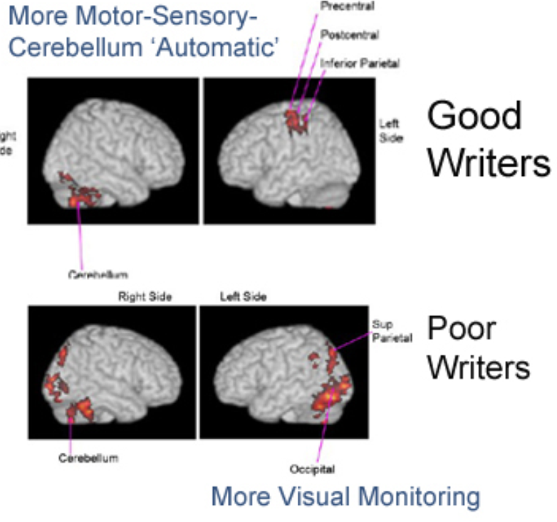
Neural Differences
Dyslexia: ↓ Language Center activation
Dysgraphia (writing)
Beneventi et al., Int J Neurisci, 2010
Richards et al., 2011
Notes:
Evidence of neuroplastic change…Dyslexias: after intervention brain activation in same areas as typical; Temple et al, PNAS 2003

Slide 11
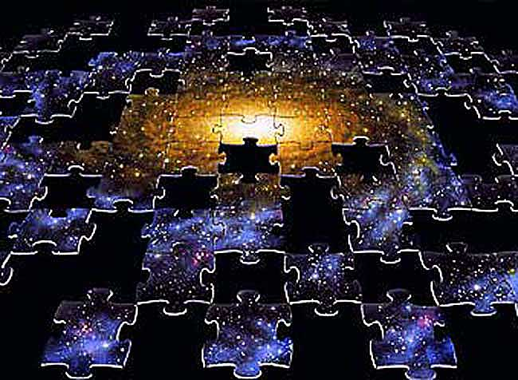

Big Picture Thinking (Interconnected Reasoning)
Ability to spot relationships between different
concepts & points of view
  multiple points of view
  borrows approaches from other disciplines
Easily sees relationships of similarities or association/causation
Strong conceptual ability in uniting disparate information into a single global view (i.e., gist)
Notes:
Big picture thinking is essentially taking past experiences or understanding patterns from past experiences and applying them to new situations.
It helps understanding if you take each new piece of information you learn and find out where it fits in the big picture so that you can more efficiently retain that information.
Graphic from: http://www.researchtoaction.org/wp-content/uploads/2012/05/social-network-analysis.jpg
Graphic from: http://apod.nasa.gov/apod/ap030303.html
Graphic from: http://easymarketingmath.com/wp-content/uploads/2015/05/big-data.jpg

Slide 12

Dynamic Reasoning
Intuits solutions, then works backwards
to check potential path(s) to solution
  Slower, more difficult discernment of path(s)
Uses the “best fit” cognitive processes rather than rule-based/deductive/formulaic thinking
Career implications: cutting edge fields , inventors & researchers
  Good reasoning for highly changeable or ambiguous situations where knowledge is incomplete
Notes:
There are many benefits to having a dynamic reasoning style.
Ease of spotting similarities and differences
Ability to integrate differing view points and aspects of either or project or presentation (example)
Instead of relying one only one way to solve a problem, you can come up with many innovative ways to deal with problems (are not confined to using limited problem solving techniques…creativity comes into play!)
Graphic from: https://3dprint.com/wp-content/uploads/2014/12/pre.jpg

Slide 13

Narrative Reasoning
Tendency to use stories to recall the past, understand the present and imagine the future
Career implications: Great for communicating a vision as a business leader, in the courtroom
Students: can use stories to boost memory
Notes:
Ability to create stories by connecting a series of mental scenes from past personal experience
Tendency to use stories to recall the past, understand the present and imagine the future
Career implications: Great for communicating a vision as a business leader, in the courtroom – communicate & connect with the jury
Students: can use stories to boost memory
Graphic from: http://www.optimistconsulting.co.uk/digital-storytelling-using-your-members/

Slide 14
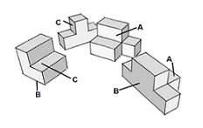
3-D Spatial Reasoning
Non-verbal reasoning
Enables reasoning about:
  The shape, size, motion, position of objects in the physical world
  Orientation in space
  The way objects in physical world interact
Spatially gifted → verbally challenged
  Arduous process of putting thoughts into words
Notes:
http://www.dyslexicadvantage.org/m-strengths-3d-spatial-reasoning-and-dyslexia/

Slide 15

What are your thoughts?
Any questions so far?
Notes:
Graphic source: http://clipartix.com/wp-content/uploads/2016/08/Questions-question-clipart-clipart-kid.jpg

Slide 16
Gold Standard Accessibility:
What is UDL?
UDL Principles ➔
Multiple Means of…
Representation
Various ways of learning the information
(e.g., hear & see)
Expression/
Action
Alternative or various ways of demonstrating they know the content
Engagement
Tapping into student’s interests & challenging them in motivating ways
The “what” of learning
The “how” of learning
The “why” of learning
Notes:
The What of learning → how our students gather facts
The how of learning → how students organize & express ideas, and plan & perform their learning/academic tasks
The why of learning → how students get engaged and stay motivated; how they get challenged, excited, or interested – it involves the affective aspects of learning

Slide 17
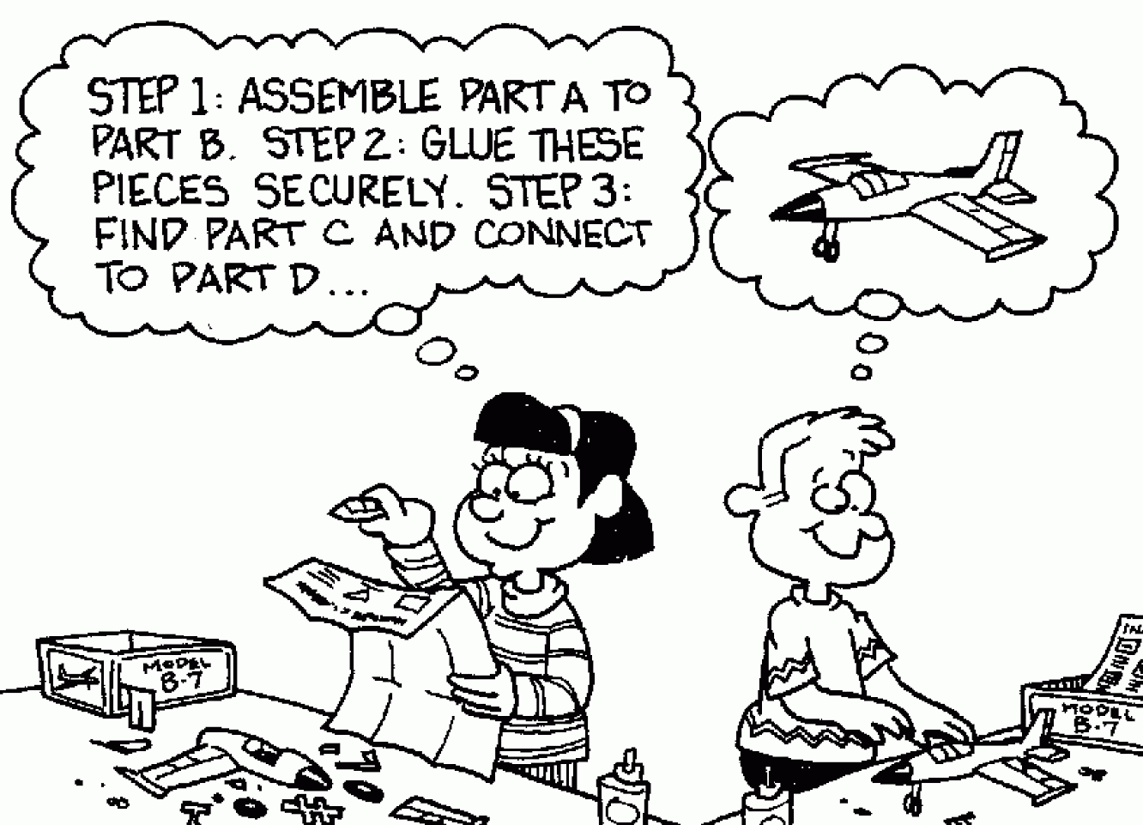
Multiple means of representation:
The “what” of learning
“can you explain this in a different way?”
“Recapping at the end of class…”
  “…just a real quick recap”
“..he just talks, I draw what he says.”
“leave it on the board just a little bit longer”
Notes:
S1450 (line 79 Y2SM2) “[I] have actually asked, can you explain this in a different way? He’s like, ‘Well, not really…’. they won’t- they kind of just repeat what they’re saying.”
S1316 (line 329 Y2SM2) “…Recapping at the end of class… my TA did something similar where at the end of every question he would go back and say like “okay, so basically all we did, we use this formula and we got this answer”- really quick, took like 30 seconds but it was so helpful. …I was like, this is the best thing ever…”
S1330 (line 344 Y2SM2) “We knew that we’re supposed to use this formula; this is how we apply this formula; this is the answer we got.’ You know, just a really quick recap of like, you know how we worked out the problem without working out every step again.”
S1302 (line 139 Y2SM2): Umm. I think it’s important because uh…or is good to share strengths and weaknesses because they could demonstrate uh strategies of how to learn in that specific class. Like in my history class specifically, umm, I’m like ‘look, these dates are not gonna fly’. Umm, but he taught me a way, when he’s lecturing, how I can use my strengths to benefit myself so- so since I’m a visual learner and he doesn’t use the board, he just talks, I draw what he says. So I just put a date on top of the drawing and I’m like, ‘alright. We’re good. We’re set’.
Image from: http://bergman-udl.blogspot.com/2011/09/providing-multiple-means-of.html

Slide 18

Multiple means of expression:
The “how” of learning
“Please bear with me…It takes me longer to understand”
  “Studying takes longer, taking my exams takes longer…”
“Clear directions, in the right order…and all parts of the instructions in one place”
“…looking around when I took my tests and getting accused of cheating when I wasn't. I need a small testing environment…”
Notes:
S1450 (line 186 Y2SM2) : Please bear with me… I have a hard time processing. It takes me longer to understand something.
S1302 (line 201 Y2SM2) I might get things a little slower, so just be aware when I ask you “what” like ten thousand times. So, don’t get mad.
S1526 (mtg?) Studying takes longer, taking my exams takes longer than them. Taking time out of my day to do quizzes in a different time period than the actual section, when I have to go to that section, anyway, to learn what happens after the quiz. All of this ends up taking up more of my time.
S1642 (y4 SM1) I have ADD and throughout my education I had the problem with looking around when I took my tests and getting accused of cheating when I wasn't. I need a small testing environment so that misunderstanding doesn’t happen.
Image from: https://openclipart.org/tags/thinking

Slide 19
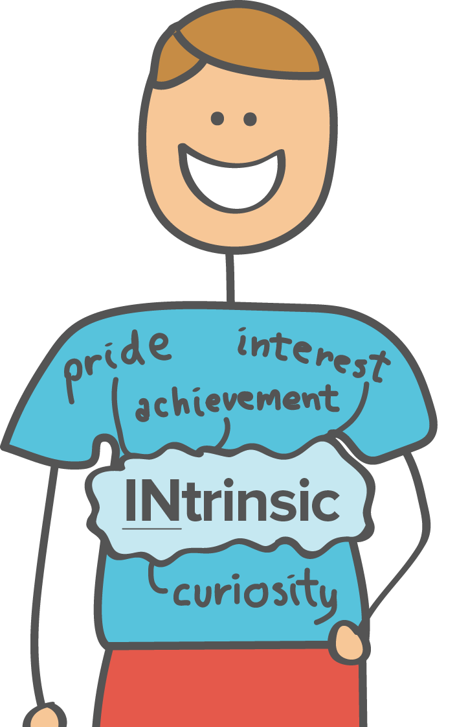
Multiple means of engagement:
The “why” of learning
“…not a copout or an excuse”
“I thought I wasn’t good enough for UF”
“I tended to just blame it on myself for being stupid”
“I never procrastinate. I don't trust myself. I do it early.”
  Course calendar very important
Notes:
S1320 (Y2SM1). “…having a learning disability is not a cop out or an excuse… we have to like, double, put twice as much energy in…”
S1434 (Y2SM2) “I thought I wasn’t good enough for UF”
S1316 (Y2SM2) “I tended to just blame it on myself for being stupid”
S1506 (YY4SM3) “Since I have such a hard time with reading clocks and calendars I like—I never procrastinate. I don't trust myself. I do it early. Yeah, my motivation is just like don't risk it. Get it done as soon as you can.
Picture from: https://www.khanacademy.org/test-prep/mcat/behavior/physiological-and-sociocultural-concepts-of-motivation-and-attitudes/a/motivation-article-2

Slide 20

In a nutshell: Concerns
Academic Misunderstanding
  “…you’re just playing the disability
  card… oh you’re just not trying hard
  enough and I’m trying, like a lot”
Different Learning Styles
  “…no one knows how hard it is to accommodate me having a learning disability because we all learn in different ways”
Health/Wellness
  “ADHD can contribute… and that of course affects my overall health…without consistent medication and then when I’m down I don’t want to exercise.”
Notes:
To summarize – our undergrads with LD have voiced some pretty consistent concerns.
They’re concerned about when their professors and TA’s misinterpret their needs regarding classroom accommodations. They continue to worry that others are perceiving their need for additional time, note takers, etc. as a copout or an excuse to get out of things or as a way of taking shortcuts
S1644 (Y4 SM1) “The TAs, they don't really know what's happening about the accommodations per se. That's mainly the professor himselves. Sometimes the TA, they really don't know how to accommodate people—like people or students with disabilities. I always notice that for myself like they may like—especially in a STEM career major like statistics, I'm in really big class sizes where we have all these TAs and they don't really know how to accommodate you. That's been a really, really huge issue on my end for sure.”
Regarding different learning styles, they are concerned that their different learning needs are not able to be addressed by the instructor – both during lectures and with regard to the structure of the class.
S1450 (Y2SM1): That one right over there, having a learning disability is not a cop out or an excuse. That one struck me because I hear that a lot like oh you’re just playing the disability card and things like that. And they’re like oh you’re just not trying hard enough and I’m trying, like a lot and it’s, it’s not a cop out or some excuse.
S1320 (Y2SM1): Actually um, I think the main thing there was having a learning disability is not a cop out or an excuse is actually, um…would be…would, how do I put this, um pretty much it becomes a case of no one knows how hard it is to accommodate me having a learning disability because we all learn in different ways.
Regarding health and wellness, students have voiced concerns related to their LD symptoms – specifically how their symptoms can impact the amount of energy that they put into their work → LD symptoms, especially when they flare up and impact things like reading speed, reading compression, memory, and attention, → these symptom flare-ups increase their stress and can cause them to loose sleep, which adds fuel to the symptom flare-ups → vicious cycle where our students end up with low energy and poor concentration/homework/classwork performance.
S1322 (Y1M6) I think also ADHD can contribute to that and that of course affects my overall health, it you know makes me more up and down, without consistent medication and then when I’m down I don’t want to exercise. I don’t want to eat right, I want to eat chocolate and lie in bed and stay um, so I think that ADHD can affect me that way.
Graphic source: https://thumbs.dreamstime.com/t/misunderstanding-18997519.jpg
Not used:
S1516 (Y3M3): “I’m s1516. My top life stressors are stresses related to accomplishing my long-term career goals. “Will I do well in this class? Will I be able to complete this assigned project and do well on it? Will I be able to go to the graduate schools I’d like to go to and be accepted to the graduate schools I’d like to go to?” My learning disability plays a big role in that, because—especially when it comes to taking tests. I struggle a lot with test-taking. One test where anxiety got the best of me can make a big difference in my long-term career goals. There’s a lot of stress there.”

Slide 21
In a nutshell: Concerns
Academic Misunderstanding
  “…you’re just playing the disability
  card… oh you’re just not trying hard
  enough and I’m trying, like a lot”
Different Learning Styles
  “…no one knows how hard it is to accommodate me having a learning disability because we all learn in different ways”
Health/Wellness
  “ADHD can contribute… and that of course affects my overall health…without consistent medication and then when I’m down I don’t want to exercise.”
Notes:
So What do these concerns mean for advisors?
Graphic source: http://clipartix.com/wp-content/uploads/2016/08/Questions-question-clipart-clipart-kid.jpg

Slide 22
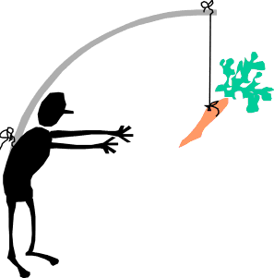
In a nutshell: Motivators
External Support
  “Positive support is a major motivation
  and will be that extra support we need
  to succeed.”
Believing in Self
  “…a lot of my motivation comes from my own feelings of self worth, and how well I feel like I get along with society…”
Stress/Competition
  I need to do more to prove myself than others and/or to compensate for the history of medical withdrawals and time out of college.”
Notes:
Our undergrads also told us some things about what motivates them:
Supports from external sources such as their mentors within the CS3LD project and instructors they perceived to be helpful, friendly and caring or at least interested in them as an individual → these supports are so important for our students
S1306: "Students with LD needs to have positivity around them at all times. Positive support is a major motivation and will be that extra support we need to succeed.”
Our students also talked about the critical importance of believing in themselves – in the fact that they are smart, even though things might be difficult for them to learn or that they learn differently from others. One student talked about how he needs to dig deep and remind himself of his abilities when he come up against his tendency for procrastination
S1638 (Y4M2): “The only issue is one of the biggest problems that I run into with procrastination is a lot of my motivation comes from my own feelings of self worth, and how well I feel like I get along with society, and for me, because my LD is a little bit more of a social disability as well, sometimes it hits me pretty hard when I’m trying to fit in and then I realize, oh, I have all these other commitments.”
While not always a positive form of motivation, our undergrads very much feel the pressures related to keeping up with their peers – especially in light of how things related to the classroom take so much longer for them because of the LD.
S1526 (Y4M2) : One of my stressors is trying to keep up with the caliber of other students and how they’re able to do so much more because they have that extra time. Whereas, I have my extra time for my classes. That feeds into my daytime, and that time they can use effectively for clubs and stuff like that. That stresses me out because I have to be just as active as them and have just as many clubs and just as good grades and all of that, as well, when I have less time to get it done.
Graphic from: http://www.clipartbest.com/cliparts/pi5/ozd/pi5ozdKkT.gif
Didn’t use: related to motivators
S1434 (Y3M8): “The only reason I ended up in one of the projects I’m in now is because my mentor suggested it to me.”
S1526 (Y4M2) : I’m S1526. One of my stressors is trying to keep up with the caliber of other students and how they’re able to do so much more because they have that extra time. Whereas, I have my extra time for my classes. That feeds into my daytime, and that time they can use effectively for clubs and stuff like that. That stresses me out because I have to be just as active as them and have just as many clubs and just as good grades and all of that, as well, when I have less time to get it done.
S1518 (Y4M2): “Competitiveness of career path and not knowing whether I need to do more to prove myself than others and/or to compensate for the history of medical withdrawals and time out of college.”
S1642 (Y4M2): Hi, I’m S1642. I guess my biggest stressor is just health, cuz I’ve been insomniatic for half of my life. I make a weekly schedule that’s pretty in-depth, but I can’t always execute it cuz I don’t have the energy to do that. Plus, I still kind of have a poor internal locus of control and I need more external factors. Like, “Oh God, if I
don’t do this I’m gonna drop out of school,” to motivate me. I wish I didn’t have to be like pushed to that point, that I could have that Zen that some people seem to have where they magically do work. I’m sure that’s not how it is, but that’s how it feels.

Slide 23
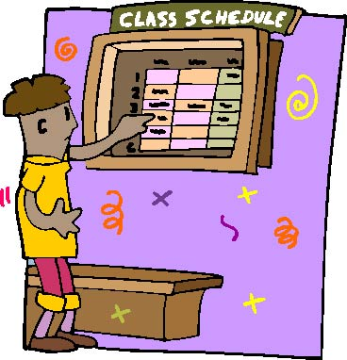
Potential Advising Practices Related to LD
Temporal Sequencing
Poor time management
  Strategic class picking
Visual learning
  Visual Rubric
  Course mapped out visually instead of with language
Notes:
Quotes from Mentors Y4M3:
(50:00) “For mechanical and aerospace engineering in undergrad, I only saw an advisor once but because they had a really nice sheet that listed the recommended order in which you take classes. They had a nice table of the course number, what semester it was offered: fall, spring, or summer so that way you knew when it was, the name of the course, the prerequisites and co-requisites, like all on one sheet and then where you had space for your technical electives. On the back side were all the courses that were eligible for your tech classes. The only thing you were really accountable for was to check if you had the pre-reqs for the tech electives but everything else was in a nice order. In general they had a really nice layout.”
(51:48) “there’s only so many ways you can take the core classes, if there are co and prerequisites, and having at least one or two different permutations of taking these 5 or 6 classes to graduate and this is how they fit together would help. I don’t feel like it’s that hard.
52:38 “Another thing that’s nice about the table was the combinations of courses, it also told you fall freshman year, sophomore year because not all classes are taught in the fall and not all in the spring so it also laid that down because that also requires planning on the students’ end. I even struggled with that in undergrad. The combination of classes is also really nice. My student has asked me several times and again, I have no idea about this, “oh can I take this class, this class, and this class in the same semester or that too much to do?” So the list could help with that.
Graphic from: http://www.cliparthut.com/clip-arts/803/class-schedule-clip-art-803275.jpg

Slide 24
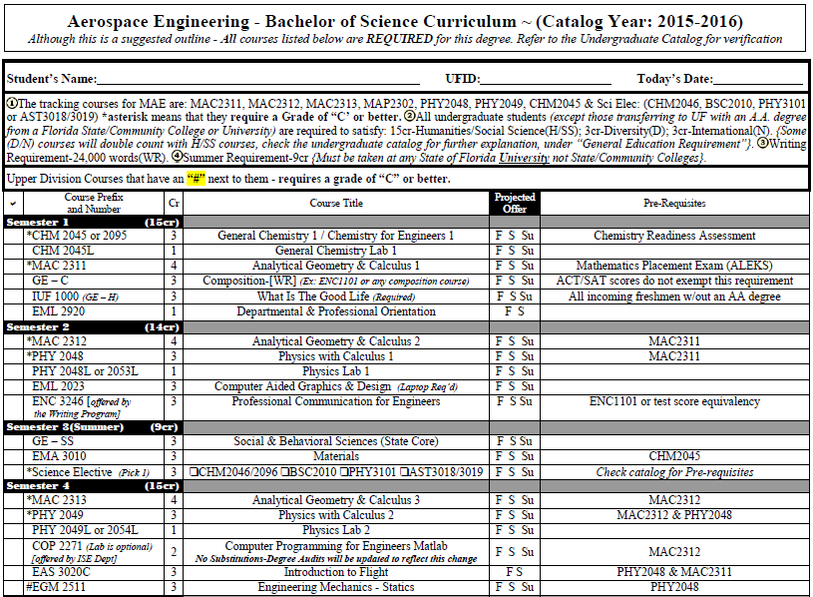

Lets look at the handout –
What are your thoughts?
“…a nice table of the course number, what semester it was offered… so that way you knew when it was…the name of the course, the prerequisites and co-requisites … all on one sheet “
Notes:
Pass out hard copies of Planning Sheet.
- Do any of the advisors have any experience in creating visual rubrics?
Table from UF’s Aerospace Engineering Advising Website
Quotes from Mentors Y4M3:
(50:00) “For mechanical and aerospace engineering in undergrad, I only saw an advisor once but because they had a really nice sheet that listed the recommended order in which you take classes. They had a nice table of the course number, what semester it was offered: fall, spring, or summer so that way you knew when it was, the name of the course, the prerequisites and co-requisites, like all on one sheet and then where you had space for your technical electives. On the back side were all the courses that were eligible for your tech classes. The only thing you were really accountable for was to check if you had the pre-reqs for the tech electives but everything else was in a nice order. In general they had a really nice layout.”
(51:48) “there’s only so many ways you can take the core classes, if there are co and prerequisites, and having at least one or two different permutations of taking these 5 or 6 classes to graduate and this is how they fit together would help. I don’t feel like it’s that hard.
52:38 “Another thing that’s nice about the table was the combinations of courses, it also told you fall freshman year, sophomore year because not all classes are taught in the fall and not all in the spring so it also laid that down because that also requires planning on the students’ end. I even struggled with that in undergrad. The combination of classes is also really nice. My student has asked me several times and again, I have no idea about this, “oh can I take this class, this class, and this class in the same semester or that too much to do?” So the list could help with that.
Table Source: http://www.mae.ufl.edu/sites/default/files/PDF/ASE-Curriculum.pdf
Graphic source: http://clipartix.com/wp-content/uploads/2016/08/Questions-question-clipart-clipart-kid.jpg

Slide 25
Implications for Student Service Providers
Student mental health providers
Disability providers
Academic advisors

Slide 26
Implications for Student Mental Health Providers/Advisors
Common co-occurring problems:
  ADHD and LD often co-occur
  Anxiety
  Depression
  Oppositional defiant disorder
  Conduct disorder
  Developmental coordination disorder
  Tic/Tourette’s disorders
  ADHD or LD rarely stands alone. A proper evaluation of the student’s struggles and needs is pivotal. It is also important to emphasize the student’s particular strengths when the student’s treatment plan is being developed.

Slide 27
Implications for Disability Providers/Advisors
Understanding LD/ADHD is important for the DRC to best support students
  Informs intake process
  Informs follow-up process
    Connects students with resources across campus
    Work with students for Strategy/Support groups at the DRC
  Campus outreach efforts
    Helps DRC tailor presentations and include information about LD/ADHD
  Collaboration across campus
    Working with partners across UF including CRC, CWC, Gator Well, MCDA, Advisors!

Slide 28
Implications for Academic Advisors
Proactively removing barriers to access and inclusion
Mindset of proactive inclusion is important because very few students with disabilities have a visible disability
Learning best practices – advisors would benefit from focused trainings on inclusive advising techniques
Inclusive practices can become more automatic over time
Notes:
Things to take into account when working with students
CS3LD research has had an impact on developing implications for advisors and tip sheet
Collaboration between CS3LD, DRC, AAC

Slide 29
Tip Sheet
Asking questions such as, “Are there a particular times of the day in which you are more or less productive/attentive?”
Being aware of the campus layout and access restrictions
Understanding teaching styles for common courses and learning styles/strategies that pair with them
Being knowledgeable about academic accommodations
Creating an accessible office set-up
Acknowledging the diversity of experiences brought by each student, increasing chances for building connections and rapport

Slide 30

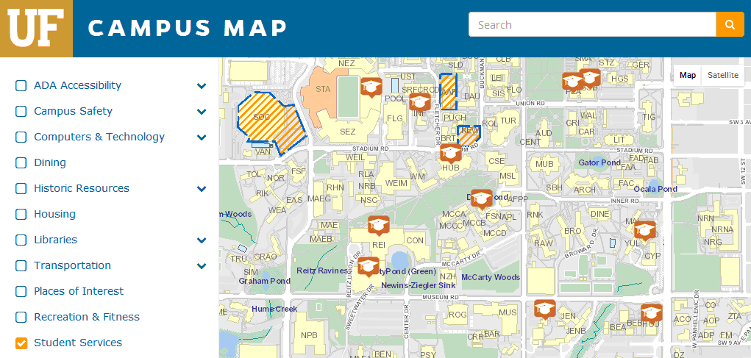
Campus Accessibility
UF Campus Map
Notes:
Campus Map includes: ADA Accessibility, Campus Safety, Computers & Technology, Dining, Historic Resources, Housing, Libraries, Transportation, Places of Interest, Recreation & Fitness, Student Services
Student Services include: Collegiate Veterans Success Center, Student Health Care Center, Dean of Students Office, Office of the Registrar, The Hub, Field and Fork Food Pantry, Reitz Student Union, UF Bookstore & Welcome Center, Disability Resource Center, University Police Department, Housing Administration, TAPS Transportation and Parking Services, Counseling and Wellness Center
Important to point out to students: under libraries – they list study rooms that can be reserved
Pass out physical maps to audience or look at campus map online
As an student service providers, what other layers or buildings do you think are resources for students on campus?
Our thoughts: 1) Supports for coping & managing stress; 2) Supports for learning & tutoring; 3) quite study spaces (indoor & outdoor)
Our team: take notes on what buildings they point out

Slide 31
What are your thoughts?
Can you think of any others tips for advisors?
Notes:
Graphic source: http://clipartix.com/wp-content/uploads/2016/08/Questions-question-clipart-clipart-kid.jpg

Slide 32
Accommodations: Why & how they help
Formal Accommodations
Students’ Key Strategies
Extended time
Low distraction
Test scribe
Note taker
Technology use in the classroom
Printed course materials
Same seat (distractions)
3 or 4 – pass method
  Read before class
Semester calendar
Visualizing what reading
Color coding
Sleep
Routine

Slide 33
Resources
UF’s CS3LD (Comprehensive Support for STEM Students with Learning Disability) http://stemscholar.phhp.ufl.edu/
National Center for Learning Disability, http://www.ncld.org/
Understood for learning & attention issues, https://www.understood.org/en
Learning Disabilities Association for America, http://ldaamerica.org/
LD On-line, http://www.ldonline.org/
PBS misundersood minds, http://www.pbs.org/wgbh/misunderstoodminds/index.html

Slide 34
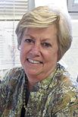
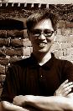
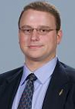

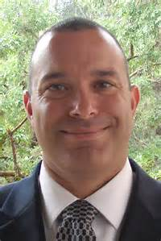
CS3LD team – it takes a village…
Our CS3LD team:
Sue Percival, PhD, Food Science & Human Nutrition
CY Wu, PhD, Environmental Engineering Sciences
Charles Byrd, PhD, Center for Assessment, Strategic Planning, Evaluation and Research
Anthony DeSantis, PhD, Associate Dean of Students, Disability Resource Center
William Mann, PhD; Anthony Delisle, PhD; Jim Gorske, Med
Beth Roland, M.A. C.A.G.S., Disability Resource Center bethr@dso.ufl.edu
Mei-Fang Lan, PhD, Counseling & Wellness Center, mlan@ufl.edu
Consuelo Kreider, PhD, OTR/L, Occupational Therapy ckreider@ufl.edu
Notes:
Add Beth!

Slide 35
Acknowledgements
HRD 1246587 National Science Foundation. Any opinions, findings, and conclusions or recommendations expressed in this material are those of the author(s) and do not necessarily reflect the views of the National Science Foundation.
K12 HD055929 National Institutes of Health – National Center for Medical and Rehabilitation Research (NICHD) and National Institute for Neurological Disorders & Stroke. The content is solely the responsibility of the authors and does not necessarily represent the official views of the National Institutes of Health.
NIH/NCATS Clinical and Translational Science Award to the University of Florida UL1TR000064 – REDCap

